Slide 1
Learning Module
SOGI + Indigeneity
SOGIeducation.org
Notes:
Learning Module Welcome 2 minutes
Sample Script:
Welcome and thank you for joining us. As you know, this is a module about sexual orientation and gender identity (SOGI). Specifically, it will look at the importance of intersectionality as we integrate SOGI and Indigenous inclusive education into all areas of the curriculum.

Slide 2
Land Acknowledgement
ARC Foundation is located on the traditional and ancestral lands of the xʷməθkʷəy̓əm (Musqueam), Sḵwx̱wú7mesh (Squamish) and səlilwətaɬ (Tsleil-Waututh) Nations.​
This acknowledgement serves as a moment to remember the truth of colonization, its historical and ongoing impacts, and will hopefully serve as a step toward respectful and reciprocal relationships in our work. All my gratitude to the caretakers of these lands, waters, and skies since time immemorial.
Notes:
Land Acknowledgement 2 minutes
Note:
Begin your presentation with a meaningful and respectful Indigenous welcome or land acknowledgement. Be sure to reach out to local Indigenous communities before your presentation to discuss the protocol and proper wording of the acknowledgement.
Sample Script:
[insert school district/school name] is located on the traditional and ancestral lands of the [insert Indigenous Nation(s)]. This acknowledgment serves as a moment to remember the truth of colonization, its historical and ongoing impacts, and will hopefully serve as a step toward respectful and reciprocal relationships in our work. All my gratitude to the caretakers of these lands, waters, and skies since time immemorial.

Slide 3
What is SOGI and SOGI 123?
Sexual Orientation
Gender Identity
Notes:
What is SOGI and SOGI 1 2 3 2 minutes
Sample Script:
Just a quick refresher: SOGI (pronounced “so-jee”) is an acronym that stands for sexual orientation and gender identity. Everyone has a sexual orientation (attraction or lack thereof) and everyone has a gender identity (understanding and experience of their gender). SOGI 1 2 3 is a set of teaching resources like videos, lesson plans and learning modules about sexual orientation and gender identity. SOGI 1 2 3 is a program that helps educators create a school environment that is inclusive and where students feel safe, accepted, respected and welcome.

Slide 4
Today’s Conversation
1
What are some key Two-Spirit and Indigiqueer terms and people that I should know?
3
How has colonialism enforced the western binary on Indigenous peoples in Canada?
2
What are Two-Spirit and Indigiqueer identities and how do they intersect with SOGI?
4
How can educators learn to be more inclusive to Two-Spirit and Indigiqueer students and families?
Notes:
Today’s Conversation 2 minutes
Sample Script:
Today, we’ll start with some key terms and people then we’ll lead into an introduction to Two-Spirit and Indigiqueer identities, we’ll discuss how this topic intersects with Indigeneity as it is important for us to consider as educators to be more inclusive to Two-Spirit and Indigiqueer students. The last area of focus today is to learn tangible ways that we can use an Indigenous lens in our SOGI-inclusive teaching practice.

Slide 5
Key Terms
1
UNDRIP
Indigeneity
Two-Spirit
Indigiqueer
5
Gender Fluid
Winkte
Nàdleehé
Berdache
2
6
3
7
4
8
Notes:
Key Terms 2 minutes
Sample Script:
In order for us to understand Indigeneity and its connection to SOGI, we first have to start with some key terms that relate to Two-Spirit Indigiqueer people. The key terms we’ll be looking at today are UNDRIP, Indigeneity, Two-Spirit, Indigiqueer, Gender Fluid, Winkte, Nádleehé, and Berdache. Which of these key terms are familiar to you? Which ones are less so?

Slide 6
Key Terms
UNRIP: United Nations’ Declaration on the Rights of Indigenous Peoples’​
Article 31
1. Indigenous peoples have the right to maintain, control, protect and develop their cultural heritage, traditional knowledge and traditional cultural expressions, as well as the manifestations of their sciences, technologies and cultures, including human and genetic resources, seeds, medicines, oral traditions, literatures, designs, sports and traditional games and visual and performing arts.
They also have the right to maintain, control, protect and develop their intellectual property over such cultural heritage, traditional knowledge, and traditional cultural expressions.
Notes:
UNDRIP 2 minutes
Note:
Emphasis the final sentence and mention that Canada has adopted UNDRIP as an inclusive framework.
Sample Script:
UNDRIP is the acronym for the United Nations’ Declaration on the Rights of Indigenous Peoples’. By learning about SOGI + Indigeneity and becoming more inclusive to Two-Spirit and Indigiqueer students you are being an active ally by acknowledging Article 31 Section 1. from UNDRIP: Indigenous peoples have the right to maintain, control, protect and develop their cultural heritage, traditional knowledge and traditional cultural expressions, as well as the manifestations of their sciences, technologies and cultures, including human and genetic resources, seeds, medicines, oral traditions, literatures, designs, sports and traditional games and visual and performing arts. They also have the right to maintain, control, protect and develop their intellectual property over such cultural heritage, traditional knowledge, and traditional cultural expressions.

Slide 7
Key Terms
Indigeneity
Is a quality of a person’s and a group’s identity that links them to specific places with knowledge of and respect for original ways.
Notes:
Indigeneity 2 minutes
Sample Script:
Indigeneity is a quality of a person’s and a group’s identity that links them to specific places with knowledge of and respect for original ways.

Slide 8
Key Terms
Two-Spirit
Is a modern, pan Indigenous term used to describe Indigenous people who fulfill a traditional third-gender ceremonial and social role in their cultures. The term was coined in 1990 at the third annual Intertribal Lesbian and Gay Conference in Winnipeg, Manitoba.
Note: To learn more about Two-Spirit click here.
Notes:
Two-Spirit 2 minutes / 7 minutes with YouTube Video
Note:
To learn more about Two-Spirit please refer to Geo Neptune’s YouTube video on what Two-Spirit means.
Sample Script:
Two-Spirit is a modern, pan Indigenous term used to describe Indigenous people who fulfill a traditional third-gender ceremonial and social role in their cultures. The term was coined in 1990 at the third annual Intertribal Lesbian and Gay Conference in Winnipeg, Manitoba.

Slide 9
Key Terms
Indigiqueer
A term that is often used by Indigenous peoples' who identify as gender diverse but do not necessarily identify as 2SLGBTQIA+ due to the abbreviation’s attachment to colonial language (i.e., English).
Note: This term is often conflated with Two-Spirit, when in fact, the two are separate ways to identify a gender expression.
Notes:
Indigiqueer 2 minutes
Note:
This term is often conflated with Two-Spirit, when in fact, the two are separate ways to identify a gender expression.
Sample Script:
Indigiqueer is another term sometimes used alongside or to refer to Two-Spirit identity, more often it is a term used by some LGBTQ+ Indigenous people who do not self-identify as Two-Spirit, or by those who identify with both.
Note:
To learn more about Two-Spirit please refer to Geo Neptune’s YouTube video on what Two-Spirit means.
Sample Script:
Two-Spirit is a modern, pan Indigenous term used to describe Indigenous people who fulfill a traditional third-gender ceremonial and social role in their cultures. The term was coined in 1990 at the third annual Intertribal Lesbian and Gay Conference in Winnipeg, Manitoba.

Slide 10
Key Terms
Gender Fluid
Someone who is fluid — also called gender fluid — is a person whose gender identity (the gender they identify with most) is not fixed. It can change over time or from day-to-day. Fluid is a form of gender identity or gender expression, rather than a sexual orientation.
Note: This term is often conflated with Two-Spirit and Indigiqueer when in fact, the three are separate ways to identify a gender expression.
Notes:
Gender Fluid 2 minutes
Note:
This term is often conflated with Two-Spirit and Indigiqueer when in fact, the three are separate ways to identify a gender expression.
Sample Script:
Someone who is fluid -- also called gender fluid -- is a person whose gender identity (the gender they identify with most) is not fixed. It can change over time or from day-to-day. Fluid is a form of gender identity or gender expression, rather than a sexual orientation.

Slide 11
Key Terms
Winkte
In Lakota, the word Winkte means “to be as a woman”.
Note: Winkte is a term that encompasses many different gender expressions in the Lakota language.
Notes:
Winkte 2 minutes
Note:
Winkte is a term that encompasses many different gender expressions in the Lakota language.
Sample Script:
In Lakota, the word Winkte means “to be as a woman”.

Slide 12
Key Terms
Nàdleehé
In Dine, the word Nàdleehé means “those who transform”. Some Dine Two-Spirits and Indigiqueers are gifted with having either “feminine feminine”, “masculine masculine”, “masculine feminine”, and other variants of diverse gender expressions.
Note: Nàdleehé is a term that encompasses many different gender expressions in the Dine language.
Notes:
Nàdleehé 2 minutes
Note:
Nàdleehé is a term that encompasses many different gender expressions in the Dine language.
Sample Script:
In Dine, the word Nàdleehé means “those who transform”. Some Dine Two-Spirits and Indigiqueers are gifted with having either “feminine feminine”, “masculine masculine”, “masculine feminine”, and other variants of diverse gender expressions.

Slide 13
Key Terms
Berdache
In French, the word berdache refers to a “kept boy”. This word is considered to be derogatory towards Indigenous communities as it’s the word that French and British colonists used to refer to Two-Spirit and Indigiqueer people during the colonization and settlement of the Americas. However, it is an important term to note as it relates to the birth of the term Two-Spirit. In 1990 Dr. Myra Laramee and other Indigenous LGBTQIA+ people adopted the term Two-Spirit in effort to establish self-determination over their gender diverse identities and communities.
Note: Since Two-Spirit's inception, Berdache is now referenced in modern academia as a trait of settler-colonialism.
Notes:
Berdache 2 minutes
Note:
Since Two-Spirit's inception, Berdache is now referenced in modern academia as a trait of settler-colonialism.
Sample Script:
In French, the word berdache refers to a “kept boy”. This word is considered to be derogatory towards Indigenous communities as it’s the word that French and British colonists used to refer to Two-Spirit and Indigiqueer people during the colonization and settlement of the Americas. However, it is an important term to note as it relates to the birth of the term Two-Spirit. In 1990 Dr. Myra Laramee and other Indigenous LGBTQIA+ people adopted the term Two-Spirit in effort to establish self-determination over their gender diverse identities and communities.

Slide 14
Key People
Examples of well known Two-Spirit and Indigiqueer people
1
Dr. Myra Laramee
TJ Cuthand
Osh-Tisch
Barbara Bruce
5
James Makokis
Jen Ferguson
Joshua Whitehead
Chelazon Leroux
2
6
3
7
4
8
Notes:
Key People 2 minutes
Sample Script:
The people we’ll be learning about today are Dr. Myra Laramee, TJ Cuthand, Osh-Tish, Barbara Bruce, James Makokis, Jen Ferguson, Joshua Whitehead, and Chelazon Leroux.
Which of these people are familiar to you? Which ones are less so?

Slide 15
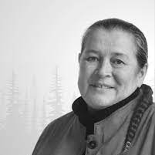
Key People
Dr. Myra Laramee
Dr. Myra Laramee is a member of the Fisher River Cree Nation. Dr. Laramee is a grandmother, mother, sister and daughter. Dr. Larmee coined the term “Two-Spirit” in 1990 at the third annual Intertribal Gay and Lesbian Conference in Winnipeg, Manitoba. Dr. Laramee continues to work in the field of education. Now in 2023, the term “Two-Spirit” is being used as a container for conversation to help Indigenous nations to reclaim their traditional and ancestral sexual orientations and gender identities.
Notes:
Dr. Myra Laramee 2 minutes
Sample Script:
Dr. Myra Laramee is a member of the Fisher River Cree Nation. Dr. Laramee is a grandmother, mother, sister and daughter. Dr. Larmee coined the term “Two-Spirit” in 1990 at the third annual Intertribal Gay and Lesbian Conference in Winnipeg, Manitoba. Dr. Laramee continues to work in the field of education. Now in 2023, the term “Two-Spirit” is being used as a container for conversation to help Indigenous nations to reclaim their traditional and ancestral sexual orientations and gender identities.

Slide 16
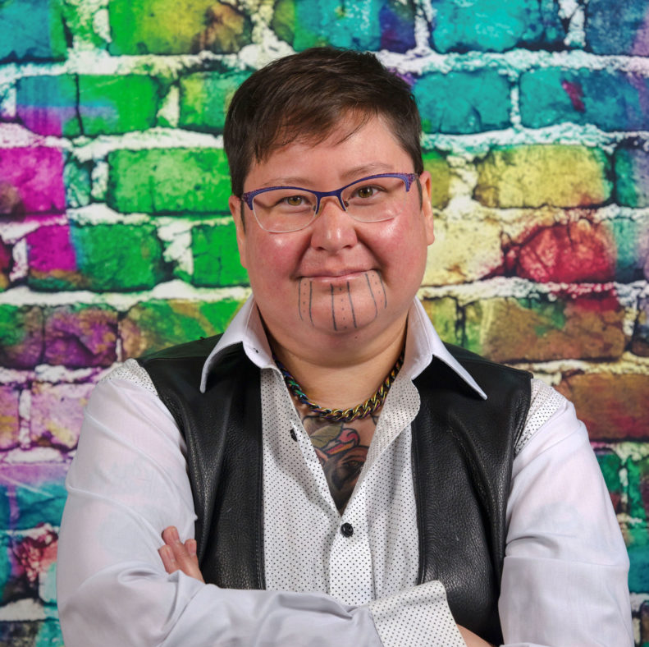
Key People
TJ Cuthand
Born in 1978 in Regina, Canada, TJ Cuthand is a prolific filmmaker exploring themes of sexuality, queer identity, Indigeneity, and love. Cuthand, a trans man of Plains Cree and Scots heritage, earned recognition, including the Hnatyshyn Foundation’s REVEAL Indigenous Art Award in 2017, and continues to expand his creative repertoire with multiple video games and feature screenplays while residing in Toronto. TJ Cuthand coined the term "Indigiqueer" in 2004.
Notes:
TJ Cuthand 2 minutes
Sample Script:
Born in 1978 in Regina, Canada, Theo Jean Cuthand is a prolific filmmaker exploring themes of sexuality, queer identity, Indigeneity, and love. Cuthand, a trans man of Plains Cree and Scots heritage, earned recognition, including the Hnatyshyn Foundation’s REVEAL Indigenous Art Award in 2017, and continues to expand his creative repertoire with multiple video games and feature screenplays while residing in Toronto. TJ Cuthand coined the term "Indigiqueer" in 2004.

Slide 17
Key People
Osh-Tisch
Osh-Tisch was known as a baté which means a woman who is assigned male at birth in the Crow linguistic community. Osh-Tisch's life and experiences are notable because they provide insights into the recognition and acceptance of diverse gender identities and roles in Native American cultures, long before the modern understanding of gender and LGBTQ+ issues. She serves as an important figure in the history of Two-Spirit people and the Crow tribe.
Notes:
Osh-Tisch 2 minutes
Sample Script:
Osh-Tisch was known as a baté which means a woman who is assigned male at birth in the Crow linguistic community. Osh-Tisch's life and experiences are notable because they provide insights into the recognition and acceptance of diverse gender identities and roles in Native American cultures, long before the modern understanding of gender and LGBTQ+ issues. She serves as an important figure in the history of Two-Spirit people and the Crow tribe.

Slide 18
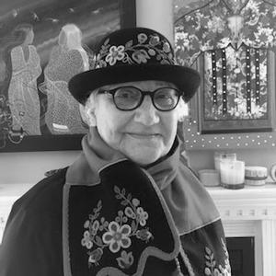
Key People
Barbara Bruce
Barbara Bruce is an entrepreneur and Elder who has spent her life working with and for the Métis Nation and First Nations communities. Early in her career, Bruce worked for several years with the Manitoba Metis Federation, including a term as executive director. In 2009, she launched her own planning and consulting firm, All My Relations Inc., focused on curriculum development, facilitation and events coordination for Indigenous cultural awareness and community-building. Bruce has served on more than two dozen boards of directors and was directly involved in planning national events for the Truth and Reconciliation Commission (TRC). Bruce is a Two-Spirit Elder who follows her traditional spiritual way of life.
Notes:
Barbara Bruce 2 minutes
Sample Script:
Barbara Bruce is an entrepreneur and Elder who has spent her life working with and for the Métis Nation and First Nations communities. Early in her career, Bruce worked for several years with the Manitoba Metis Federation, including a term as executive director. In 2009, she launched her own planning and consulting firm, All My Relations Inc., focused on curriculum development, facilitation and events coordination for Indigenous cultural awareness and community-building. Bruce has served on more than two dozen boards of directors and was directly involved in planning national events for the Truth and Reconciliation Commission (TRC). Bruce is a Two-Spirit Elder who follows her traditional spiritual way of life.

Slide 19
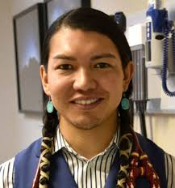
Key People
James Makokis
Makokis operates a clinic in the Enoch Cree Nation 135 serving the Kehewin and Enoch Cree Nation, and a satellite clinic in Edmonton, Alberta. Makokis is an indigenous two-spirit person and is particularly noted for treating transgender people from the Cree communities and around the world, with many patients traveling from long distances to see him. Their practices combines traditional Cree and Western medical practices.
Notes:
James Makokis 2 minutes
Sample Script:
Makokis operates a clinic in the Enoch Cree Nation 135 serving the Kehewin and Enoch Cree Nation, and a satellite clinic in Edmonton, Alberta. Makokis is an Indigenous Two-Spirit person and is particularly noted for treating transgender people from the Cree communities and around the world, with many patients traveling from long distances to see him. Their practices combine traditional Cree and Western medical practices.

Slide 20
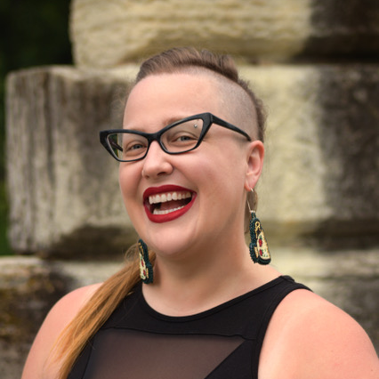
Key People
Jen Ferguson
Jen, a Métis with Red River ancestral ties on her father's side and a Canadian settler on her mother's side, is an activist, feminist, auntie, and accomplished writer with a PhD in English and Creative Writing. She views writing, teaching, and beading as political acts. Her debut YA novel, "The Summer of Bitter and Sweet," received the 2022 Governor General's Literary Award and is a 2023 Stonewall Honor Book, among other recognitions. Her latest work, "Those Pink Mountain Nights," is a Junior Library Guild Gold Selection and has garnered four starred reviews. Additionally, her novella "Missing" won the Malahat Review's 2022 Novella Prize, and her essay "Off Balance" was featured in the Best Canadian Essays 2020.
Notes:
Jen Ferguson 2 minutes
Sample Script:
Jen, a Métis with Red River ancestral ties on her father's side and a Canadian settler on her mother's side, is an activist, feminist, auntie, and accomplished writer with a PhD in English and Creative Writing. She views writing, teaching, and beading as political acts. Her debut YA novel, "The Summer of Bitter and Sweet," received the 2022 Governor General's Literary Award and is a 2023 Stonewall Honor Book, among other recognitions. Her latest work, "Those Pink Mountain Nights," is a Junior Library Guild Gold Selection and has garnered four starred reviews. Additionally, her novella "Missing" won the Malahat Review's 2022 Novella Prize, and her essay "Off Balance" was featured in the Best Canadian Essays 2020.

Slide 21
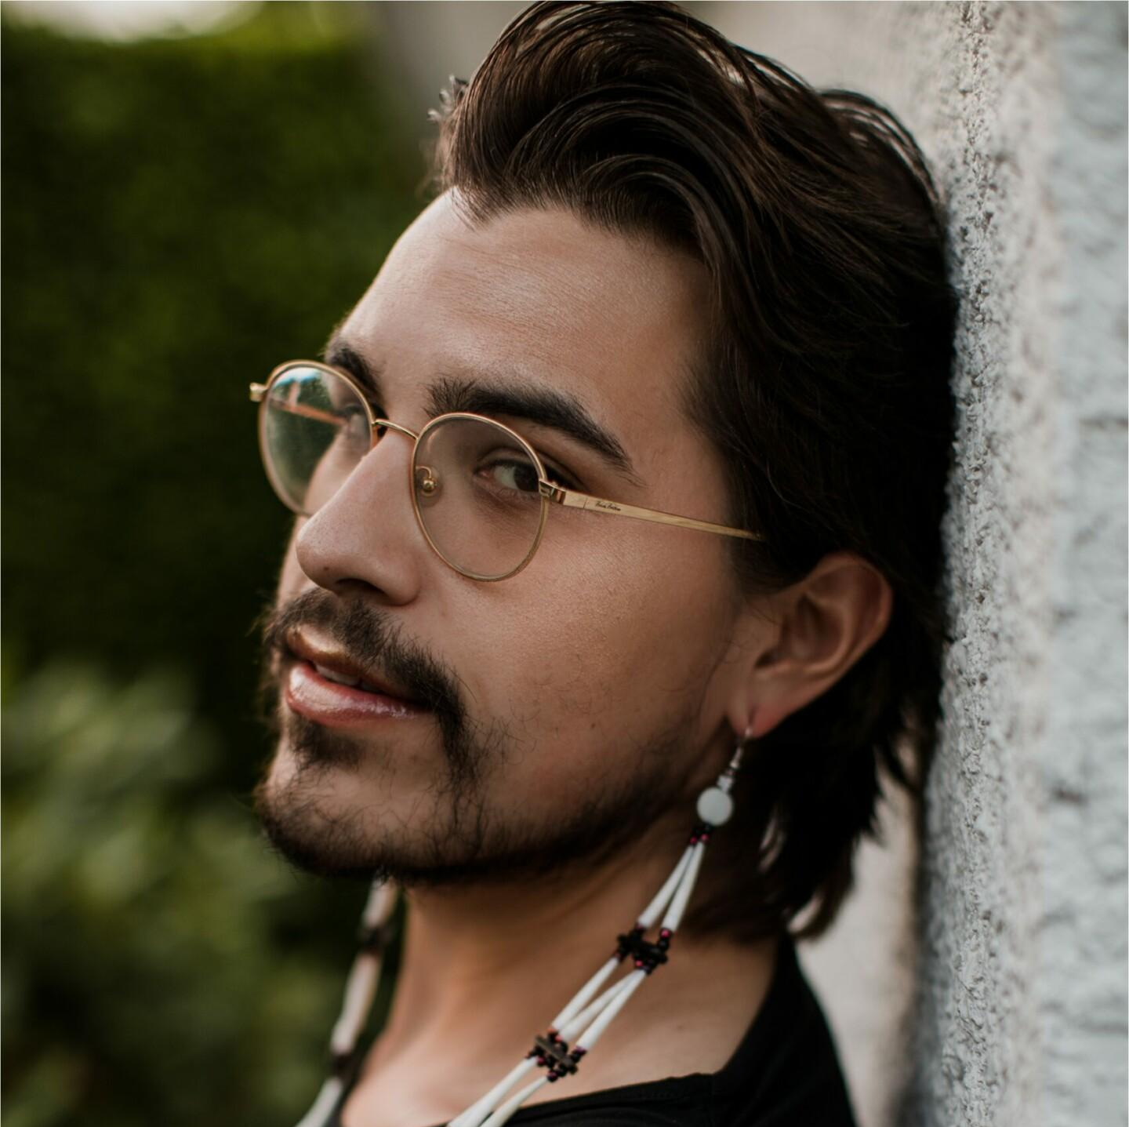
Key People
Joshua Whitehead
Joshua Whitehead is a Canadian author, poet, and academic known for his work in contemporary Indigenous literature and LGBTQ+ literature. He is a member of the Peguis First Nation in Manitoba, Canada, and is Two-Spirit. Whitehead's writing often explores themes of identity, queerness, and the experiences of Indigenous peoples in Canada. He gained recognition for his debut novel, "Jonny Appleseed," which won the Governor General's Literary Award for Fiction in 2018 and was a finalist for the Lambda Literary Award. Whitehead's work is celebrated for its unique and powerful storytelling that reflects the intersection of Indigenous and LGBTQ+ experiences.
Notes:
Joshua Whitehead 2 minutes
Sample Script:
Joshua Whitehead is a Canadian author, poet, and academic known for his work in contemporary Indigenous literature and LGBTQ+ literature. He is a member of the Peguis First Nation in Manitoba, Canada, and is Two-Spirit. Whitehead's writing often explores themes of identity, queerness, and the experiences of Indigenous peoples in Canada. He gained recognition for his debut novel, "Jonny Appleseed," which won the Governor General's Literary Award for Fiction in 2018 and was a finalist for the Lambda Literary Award. Whitehead's work is celebrated for its unique and powerful storytelling that reflects the intersection of Indigenous and LGBTQ+ experiences.

Slide 22
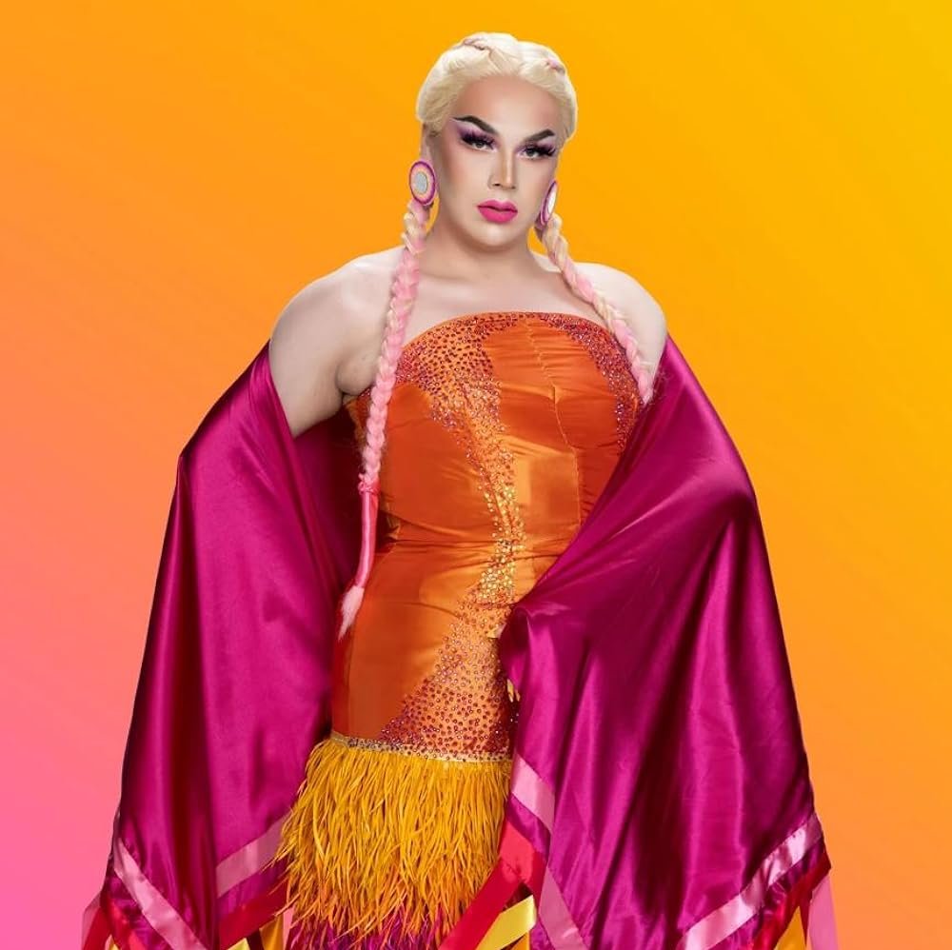
Key People
Chelazon Leroux
Chelazon Leroux is a Canadian drag performer who competed on season 3 of Canada's Drag Race. Chelazon Leroux was raised in Saskatchewan. She has more than 500,000 Tiktok followers. She walked in London Fashion Week in 2021, and is also a public speaker. She has also hosted a series of beauty tutorials called Deadly Like Auntie. Chelazon Leroux is Two-Spirit and uses the pronouns he/she/they in and out of drag. She considers Buffalo Dene First Nation home.
Notes:
Chelazon Leroux 2 minutes
Sample Script:
Chelazon Leroux is a Canadian drag performer who competed on season 3 of Canada's Drag Race. Chelazon Leroux was raised in Saskatchewan. She has more than 500,000 Tiktok followers. She walked in London Fashion Week in 2021, and is also a public speaker. She has also hosted a series of beauty tutorials called Deadly Like Auntie. Chelazon Leroux is Two-Spirit and uses the pronouns he/she/they in and out of drag. She considers Buffalo Dene First Nation home.

Slide 23
How does SOGI and Indigeneity Intersect?
Everyone’s sexual orientation and gender identity make up part of who they are, and cultural contexts attribute to diverse sexual and gender expressions, including Indigenous knowledge systems and peoples.
Indigenous queer peoples such as Two-Spirits and Indigiqueers have been in existence since time immemorial.
Notes:
How Does SOGI and Indigeneity Intersect? 2 minutes
Sample Script:
Everyone’s sexual orientation and gender identity make up part of who they are, and cultural contexts attribute to diverse sexual and gender expressions, including Indigenous knowledge systems and peoples. Indigenous queer peoples such as Two-Spirits and Indigiqueers have been in existence since time immemorial.

Slide 24
VIDEO
SOGI + Indigeneity
As you watch this video, consider these questions:
1
How does this video inspire further ideas on how to include Indigenous intersectional SOGI content in the classroom?
3
Are there ways you could use this video at a staff meeting presentation, classroom lesson, or school assembly?
2
How does Indigeneity relate to your role as an educator?
Notes:
Video: SOGI + Indigeneity 10 minutes
Sample Script:
Next, we will watch a video that will give more details about why being inclusive to Two-Spirits and Indigiqueers in K-12 education is important. As you take this video in, I encourage you to reflect on the following questions: 1. How does this video inspire further ideas on how to include Indigenous intersectional SOGI content in the classroom? 2. How does Indigeneity relate to your role as an educator? 3. Are there ways you could use this video at a staff meeting presentation, classroom lesson, or school assembly?
Play Video:
https://youtu.be/FAwpFCnAgh4

Slide 25
SELF-REFLECTION ACTIVITY
Colonialism and Indigenous Knowledges
Reflect on your answers to the following questions:
1
What are some ways that Indigenous communities were forced into the western gender binary?
3
What are some ways in which I have benefited from Indigenous knowledges and how can I be a better ally?
2
What are some ways in which I have benefited or not benefited from colonialism and the western binary?
Notes:
Reflection Activity 5 minutes
Note:
Challenge yourself to think of parts of your identity in which you have privilege and parts of your identity in which you are the recipient of discrimination or oppression. Did watching the video give you more ideas on the various identities you may hold or how you might be able to teach from an intersectional perspective (i.e., SOGI + Indigeneity)?
Sample Script:
Now that you’ve watched the video, take the next 5 minutes to reflect on these questions:
1. What are some ways that Indigenous communities were forced into the western gender binary?
2. What are some ways in which I have benefited or not benefited from colonialism and the western binary?
3. What are some ways in which I have benefited from Indigenous knowledges and how can I be a better ally?

Slide 26
DISCUSSION ACTIVITY
The Western Gender Binary
Get into groups of 2-5 and discuss the following:
1
How were Indigenous communities forced into the western gender binary?
3
How have educators benefited from Indigenous knowledges and how can we become better allies?
2
How have educators benefited or not benefited from colonialism and the western binary?
Notes:
Discussion Activity 10 minutes
Note: Challenge yourself to think of how the western gender binary has continued to assimilate and erase Two-Spirit and Indigiqueer identities.
Sample Script:
Get into groups of 2-5 people and discuss the following:
1. How Indigenous communities were forced into the western gender binary?
2. How have educators benefited or not benefited from colonialism and the western binary?
3. How have educators benefited from Indigenous knowledges and how we can become better allies?

Slide 27
Two-Spirit/Indigiqueer Data
Data:
Two-Spirit and Indigiqueer students have reported feeling unsafe in change rooms, washrooms, hallways, classrooms and school yards, and report frequently experiencing homophobia, bullying, verbal and sexual harassment, fights, rejection, and destruction of personal property. They also report not knowing if they can ask educators for help, or if their school has policy preventing homophobic bullying.
(Safe and Caring Schools for Two-Spirit Youth, 2011.)
Notes:
Two-Spirit/Indigiqueer Data 2 Minutes
Sample script: (More data) In an UNYA survey, 73% of the respondents believe that negative stereotypes in school leads to drop-outs of Two-spirit youth, and 78% of the respondents believe their community needed more education with respect to sexual/cultural diversity. Unfortunately, 38% stated they did not feel accepted in their community, and 37% indicated that the First Nations community is not accepting of its Two-Spirit people.
In the Walking in Two Worlds Report, 56% Two-Spirit transgender participants reported attempting suicide, 46% reported being rejected by family, 45% reported family violence, and 74% reported losing friendships due to being Two-Spirit.

Slide 28
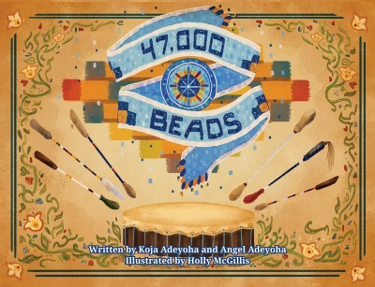
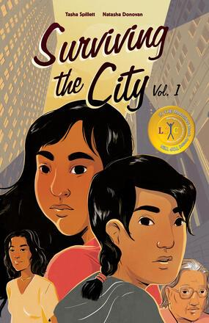
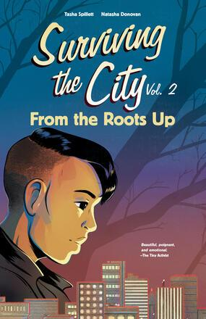
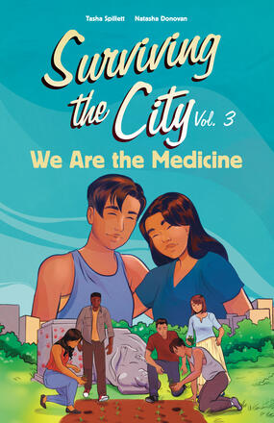
Resource Connections
Books:
47,000 Beads
Fire Song
Surviving the City Vol. 1, 2, and 3
Notes:
Resource Connections 5 minutes
Sample Script:
Here are some other resources that can help scaffold your school's learning about Two-Spirit and Indigiqueer identities. First, some books for different ages.

Slide 29
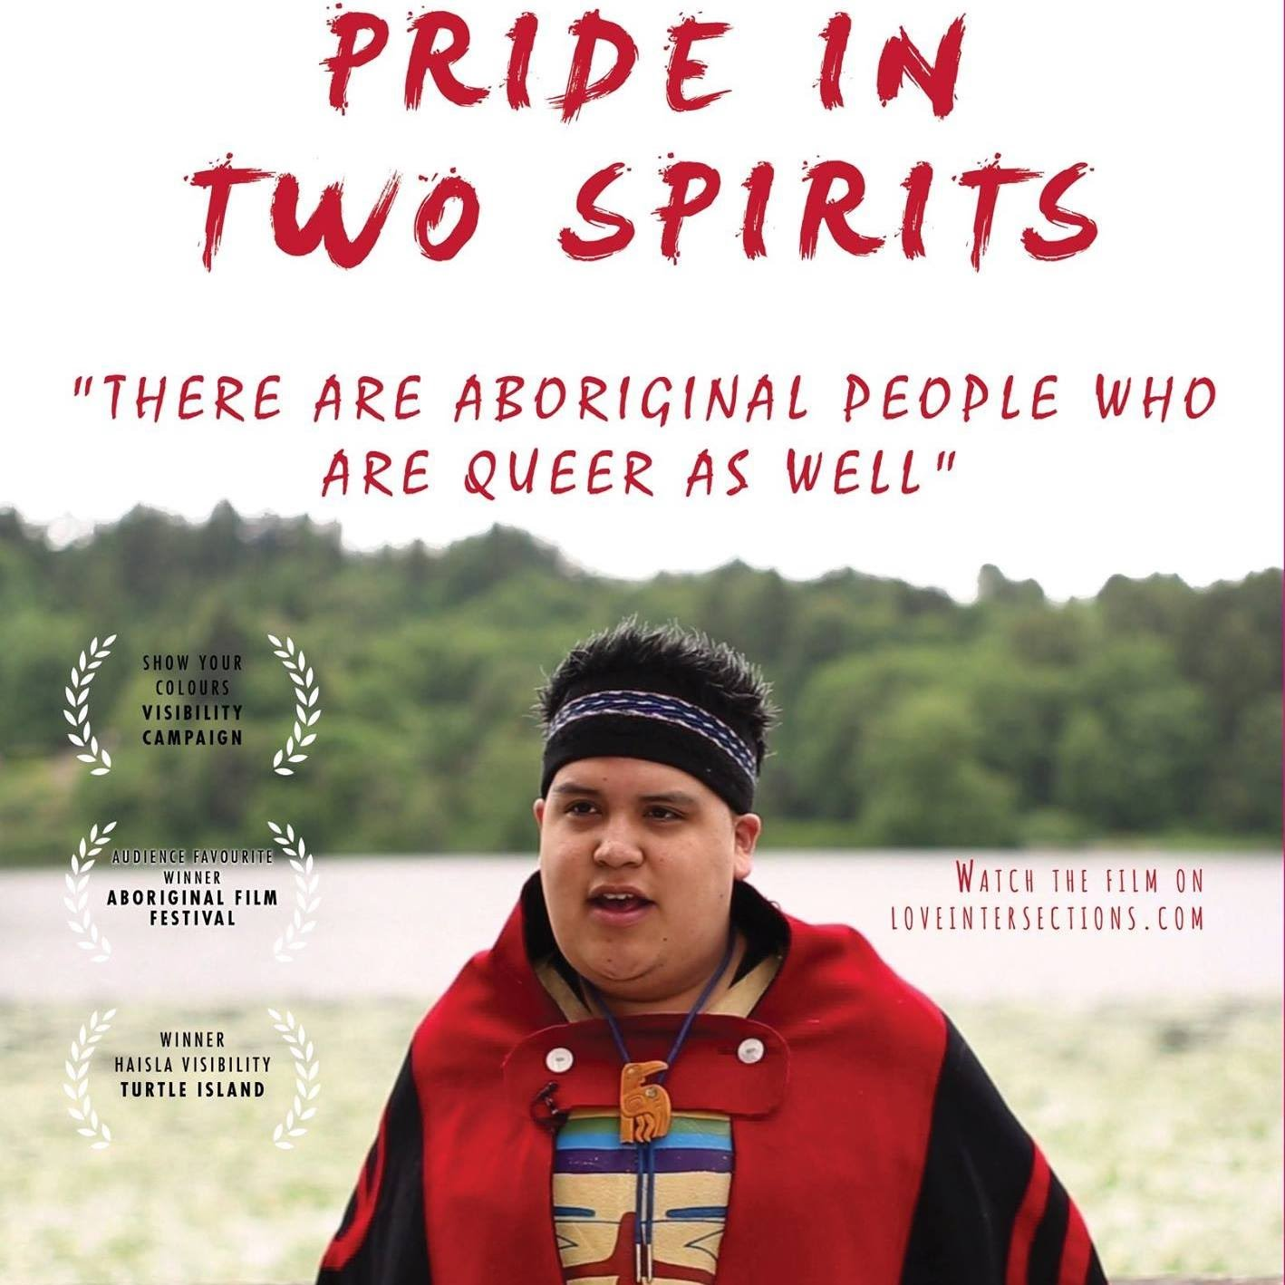
Resource Connections
Videos:
A Two-Spirit Journey
Regalia: Pride in Two Spirits
Two-Spirit: A Movement Born in Winnipeg
Two Spirit LGBTQ+ Fundamentals
Vera City: Indigiqueer
What Does Two-Spirit Mean?
Notes:
Resource Connections 5 minutes
Sample Script:
Here are some other resources that can help scaffold your school's learning about Two-Spirit and Indigiqueer identities. First, some books for different ages.
UNYA Two Spirit Collective
https://2spiritsbc.com

Slide 30
Check-Out
1
What’s one thing you’ve learned about Two-Spirit and Indigiqueer identities that you can apply within your teaching practice?
2
Were all of your questions answered? Do any remain?
Where could you go to find answers to any questions you may have in the future?
Notes:
Check-Out 5 minutes
Sample Script:
Before we finish our time together, let’s take a moment to reflect. Please answer the following questions as you check-out:
1. What’s one thing you’ve learned about Two-Spirit and Indigiqueer identities that you can apply within your teaching practice?
2. Were all of your questions answered? Do any remain? Where could you go to find answers to any questions you may have in the future?

Slide 31
Questions?
Q & A Period
Notes:
Q & A 5 minutes
Sample Script:
Questions?

Slide 32
Thank You | Merci Support all students.
Visit SOGIeducation.org
Notes:
Thank You 2 minutes
Sample Script:
Thank you for participating and learning! To learn more and get answers to your questions, you can connect with me one-on-one, visit SOGIeducation.org, contact the SOGI School/District Leads, or email your Provincial SOGI Education Lead at info@sogieducation.org.

