Slide 1
Parent Community
SOGI-Inclusive Education
SOGIeducation.org
Notes:
Sample Script:
Welcome and thank you for joining us.
This is an introduction to SOGI-inclusive education for the parent community of students in the BC education system. Today we will learn about SOGI, SOGI-inclusive education and how these relate to SOGI 123.

Slide 2
Land Acknowledgement
ARC Foundation is located on the traditional and ancestral lands of the xʷməθkʷəy̓əm (Musqueam), Sḵwx̱wú7mesh (Squamish) and səlilwətaɬ (Tsleil-Waututh) Nations.​
This acknowledgement serves as a moment to remember the truth of colonization, its historical and ongoing impacts, and will hopefully serve as a step toward respectful and reciprocal relationships in our work. All my gratitude to the caretakers of these lands, waters, and skies since time immemorial.
Notes:
2 minutes
Note: Begin your presentation with a meaningful and respectful Indigenous welcome or land acknowledgement. If needed, reach out to local Indigenous communities before your presentation to discuss the protocol and proper wording of the acknowledgement.
You can edit the left to reflect the land that your presentation is occurring on. You are welcome to leave the left side which is the SOGI 123 wording, or edit it to reflect messaging from your area.
Sample Script:
[insert school district/school name] is located on the traditional and ancestral lands of the [insert Indigenous Nation(s)]. This acknowledgment serves as a moment to remember the truth of colonization, its historical and ongoing impacts, and will hopefully serve as a step toward respectful and reciprocal relationships in our work. All my gratitude to the caretakers of these lands, waters, and skies since time immemorial.

Slide 3
Introductions
First name Last name (Pronoun)
A description of presenter(s)
Notes:
1 minute
Note: Insert an introduction to any speakers or facilitators here If more than one presenter you can duplicate this slide to have a slide for each speaker
You are welcome to include a picture of the speaker in the picture icon
Sample Script:
Presenter introduces themselves

Slide 4
The plan
1
What is SOGI What is SOGI-inclusive Why is it important? What is SOGI 123
5
SOGI in your school
In-class examples GSAs What can you do at home
2
6
3
7
4
8
Notes:
1 minute
Overview of today’s session
Be sure to edit school to district or division depending on how broadly this presentation applies
Sample Script:
Today we will discuss the term SOGI, as well as SOGI 123 and SOGI-inclusive education. We will explore examples of what this might look like in your school as well as what you can do at home to support your children

Slide 5
What is SOGI and SOGI 123?
Sexual Orientation
Gender Identity
Notes:
What is SOGI and SOGI 123
2 minutes
Sample Script:
SOGI (pronounced “so-jee”) is an acronym that stands for sexual orientation and gender identity. Everyone has a sexual orientation (attraction or lack thereof) and everyone has a gender identity (understanding and experience of their gender). This is different from the other acronym you may be familiar with, 2SLGBTQ+
Some students may be unsure of their sexual orientation or gender identity. Others may identify specifically as Two Spirit, lesbian, gay, straight, bisexual, transgender, queer, cisgender, or another word not listed her.
SOGI 123 is a set of teaching resources like videos, lesson plans and learning modules about sexual orientation and gender identity. SOGI 123 helps educators create a school environment that is inclusive and where students feel safe, accepted, respected and welcome.

Slide 6
What is SOGI-inclusive education?
SOGI-inclusive schools are safe and welcoming places for students of all sexual orientations, gender identities and family structures.
SOGI-inclusive education can apply to all classrooms, subjects, and age groups. It is not a curriculum or single lesson plan.
Notes:
2 minutes
Sample Script:
SOGI-inclusive education is inclusive of SOGI diversity in society and the classroom, and the importance of treating everyone with dignity and respect.
SOGI is one of many topics about diversity discussed regularly in schools, such as when educators speak about race, ethnicity, religion, and ability. SOGI-inclusive education simply means speaking about SOGI in a way that ensures every student feels like they belong. There is no "SOGI curriculum." SOGI is a topic that can be addressed throughout many subjects and school activities.
A SOGI-inclusive school means all these experiences and identities are embraced and never cause for discrimination.

Slide 7
Why is SOGI-inclusive education happening?
Human Rights Code and school codes of conduct
The 2016 BC Human Rights Code amendment adds gender identity and expression as a prohibited ground of discrimination (joining sexual orientation).
A 2016 Ministerial directive requires all schools (independent and public) to reference sexual orientation and gender identity in all policies or codes of conduct.
Notes:
2 minutes
Sample Script:
Sexual orientation and gender identity and expression are protected against discrimination in all Human Rights Codes in Canada.
]
Schools address bullying by having codes of conduct that name all areas protected from discrimination in their local Human Rights Code—including acceptable and unacceptable behaviours and consequences. Schools codes of conduct should include behaviours and consequences related to SOGI, along with all other protected areas.
Proactively creating SOGI-inclusive environments by celebrating diversity, and integrating different identities into learning, is a part of following the Human Rights Code.

Slide 8
Why is SOGI-inclusive education important and necessary?
The stats
64% of students report hearing homophobic slurs such as ‘that’s so gay!’ every day in school. Numbers are consistent across all identities.
SOGI-inclusive school policies are linked to better academic outcomes and lowering negative behaviours for all youth, not just 2SLGBTQ+ youth.
Nearly all mental health indicators including suicide rates are higher for LGBQ students compared to straight youth, and higher still for trans youth.
Notes:
1 minute
Sample Script:
Research shows that creating an inclusive school has better outcomes, both academically and socially, for all students – including straight and cisgender students.
Numbers come from UBC School of Nursing’s Safe and Resilient Youth surveys, and Egale, a national LGBTQ+ non-profit.
Sources:
https://news.gov.bc.ca/factsheets/sexual-orientation-and-gender-identity-sogi-in-schools
Saewyc E., Poon C., Kovaleva K., Tourand J., & Smith A. (2016). School-based
interventions to reduce health disparities among LGBTQ youth: Considering the evidence. Vancouver:
McCreary Centre Society & Stigma and Resilience Among Vulnerable Youth Centre.
Saewyc E., Konishi C., Homma Y. & Poon C.(2013) Population-level evaluation of school-based interventions to prevent problem substance abuse among gay, lesbian and bisexual adolescents in Canada. Vancouver: McCreary Centre Society & School of Nursing, University of British Columbia.
Saewyc, E., Wang, N., Chittenden, M., Murphy, A., & The McCreary Centre Society (2006). Building Resilience in Vulnerable Youth. Vancouver, B.C.: The McCreary Centre Society.
: https://egale.ca/backgrounder-lgbtq-youth-suicide/

Slide 9
What is SOGI 123
SOGI 123 creates professional development and classroom resources with educators for educators that are ready to use, easy to access, and open to customization.
SOGI 123 is simply one more way that educators can find the resources they need and learn from each other.
Notes:
1 minute
Sample Script:
SOGI 123 is a resource for educators to make their classrooms, schools, and districts more SOGI-inclusive. SOGI 123 makes educator resources accessible across the country. Educators can choose if and when they want to use SOGI 123 resources in their classrooms as there is no required SOGI lesson plan

Slide 10
What is SOGI 123
1
Policies and Procedures that explicitly reference sexual orientation and gender identity reduce discrimination and create safer learning environments for all students.
2
Inclusive environments — including SOGI-inclusive signage, word choices, and extra-curricular opportunities — create a positive and welcoming space for all students.
3
Classroom resources and lesson plans that teach diversity and respect and include examples of SOGI topics and 2SLGBTQ+ community members reflect the SOGI diversity in students’ lives and society.
Notes:
4 minutes
Sample Script:
SOGI 123 gets its named from its three-pronged approach to SOGI-inclusive education. When all three pillars of SOGI 123 are present in schools, all parents, staff and students feel welcome.
SOGI 1: Is for districts looking to create or improve SOGI policies. Policies and procedures that explicitly reference SOGI have been proven to reduce discrimination, suicidal ideation, and suicide attempts for all students.
SOGI 2: Is about inclusive learning environments. This can include school-wide initiatives, SOGI-inclusive posters or signs, extra-curricular opportunities or the even the way the school is built. All these things create a positive and welcoming space for all students.
SOGI 3: Focuses on classroom resources from recommended book lists to lesson plans for grades K through 12. Lesson plans across multiple subjects that teach diversity and respect and include examples of SOGI issues and 2SLGBTQ+ community members allow learning to reflect the SOGI diversity in students' lives and society.
As you see, SOGI 123 includes the district, the whole school, as well as the classroom. It’s so much more than what is being taught.

Slide 11
What does SOGI-inclusive education look like?
In class
 | Sexual Orientation (SO) | Gender Identity (GI)
Primary Intermediate Secondary | Family diversity Same-sex families Using “gay” appropriately LGBT history, human rights Global LGBT rights Discrimination Contributions Artistic expression Political Legal Literature | Gender stereotypes What is Gender Trans history, human rights Global trans rights Difference between gender and sexuality Discrimination Contributions Artistic expression Political Legal Literature
Notes:
2 minutes
Sample Script:
SOGI-inclusive education is about students having conversations about diversity and the importance of treating everyone with dignity and respect. Teachers are best equipped to determine what is age appropriate for their students.
For example, a K/1 lesson on family diversity might teach that families can take many forms; single dads, grandparents, stepparents, or two moms.
Another lesson may discourage students from saying “that's so gay,” which directly impacts the welcoming atmosphere of schools. SOGI 123 lesson plans are an optional resource for educators. They align with your provincial curriculum and are meant to be customized by educators as they desire.

Slide 12
What does SOGI-inclusive education look like?
In the school
SOGI-inclusive education provides a mirror for some students and families to see themselves reflected and a window for all students to see the diversity that exists in society.
Notes:
3 minutes
Task: Read this slide out loud. Ask participants to reflect on what aspects of diversity and inclusion are important to them in the school environment.
Sample Script:
Inclusion and diversity are commonly discussed in schools. SOGI-inclusive education is about so much more than what is taught in class. It is about creating a culture of inclusion within the whole school.
Educators have a responsibility to reflect the diversity that we see in our school communities.
By discussing diversity and discouraging discrimination, students are better able to be themselves and welcome the differences in their peers.

Slide 13
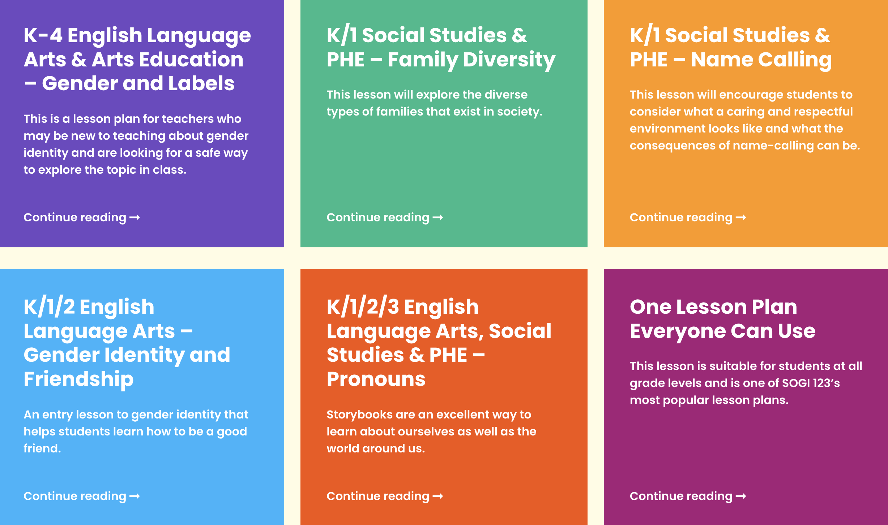
What does SOGI-inclusive education look like?
In elementary classrooms
Notes:
2 minutes
Note: This slide is optional depending on the interests of the audience.
Sample Script
Teaching about SOGI is similar to teaching about religions or cultures – we teach ”about” different religions, but don’t teach that students should be any of those religions.
The lesson plans listed on this slide come from the SOGI 123 website. Teachers can adjust all lesson plans as they see fit, and all lesson plans are aligned with curriculum.
Each of these lesson plans give teachers ways to start discussions in the classroom. Notice how the material changes as the students mature. For example, primary lessons will be on family diversity and intermediate lessons will discuss stereotypes that we may face.

Slide 14
What does SOGI-inclusive education look like?
In secondary classrooms
Notes:
2 minutes
Note: This slide is optional depending on the interests of the audience.
Sample Script
Teaching about SOGI is similar to teaching about religions or cultures – we teach ”about” different religions, but don’t teach that students should be any of those religions.
The lesson plans listed on this slide come from the SOGI 123 website. Teachers can adjust all lesson plans as they see fit, and all lesson plans are aligned with the BC curriculum.
Each of these lesson plans give teachers ways to start discussions in the classroom. Notice how the material changes as the students mature. For example, primary lessons will be on family diversity and intermediate lessons will discuss stereotypes that we may face.

Slide 15
What does SOGI-inclusive education look like?
GSAs
GSA typically stands for Gender-Sexuality Alliance. There are many other names a school might use from Rainbow club to Diversity club.
GSAs are peer support networks run by students and supported by school staff and promote a safe place for all students.
Notes:
2 minutes
Note: This slide is optional depending on the interests of the audience.
GSA typically stands for Gender-Sexuality Alliance. There are many other names a school might use from Rainbow Club to Diversity club or Queer-Straight Alliance
GSAs are typically are run by students and ensure a safe place in the school. The group will be sponsored by a staff member, and will meet to discuss topics, organize activities and support one another.

Slide 16
SOGI-inclusive education in your school
And anything here
Focus on your school, district/division, or entire region depending on the context of this presentation
Notes:
Note: This slide is optional for you to add anything specific you would like to include about your school, district or division, or even region depending on the context of this presentation.
Consider including things like local policies that apply to SOGI or anti-harassment and discrimination, or any initiatives that your school or district/division are taking on.

Slide 17
VIDEO
SOGI 123 Parents Video
Let’s watch:
1
Elementary focus
2
Secondary focus
Notes:
8 minutes
Task: Introduce and play the video that best suits your audience.
Sample Script:
Next we will watch a SOGI 123 Parent Resources video that provides more insight into what SOGI-inclusive education and SOGI 123 can look like in the classroom.
Note: These videos were made in BC. We hope that the majority of the message stays relevant for your audience if you are outside of BC, but please review before screening.

Slide 18
What can you do at home?
Share the values of acceptance and respect
Be curious and learn about SOGI topics with your child
Open up the conversation
Talk to your child’s teacher
Notes:
2 minutes
Task: distribute parent brochure found on SOGIeducation.org/parents
Sample Script:
Kids have questions, and we can be curious together. At home, you and your child can talk about topics of sexual orientation and gender identity with an open mind and a place of acceptance. For example, for older children, parents can pose a scenario that they would like help with. “How do I tell Grandma it’s OK for our friend to be gay?”.
Talk to your child's teachers to learn what they are teaching in the classroom and how SOGI-inclusive education is being achieved at your child's school.
Choose a SOGI-related age-appropriate book to read at home and discuss with your children.
Watch the videos on SOGIeducation.org and read more about what’s happening your region at www.sogieducation.org/updates

Slide 19
What can you do at home?
Kids have questions. Be curious together.
If your child comes out (or you think they might)
If your child has questions about others’ gender or sexuality
Community resources: PFLAG, youth support groups
Notes:
2 minutes
Sample Script:
Find ways to bring it into conversation. Mention people in your life that are LGBTQ positively. Practice using they/them pronouns for someone you don’t know like a kid at the playground. Example gender stereotypes – affirm that boys can wear pink and have long hair. Drop hints – kids who are looking for you to be affirming will notice.

Slide 20
Questions?
Q & A Period
Notes:
Time as allows
Task: Encourage participants to learn more and get answers to questions by connecting with you one-on-one, visiting SOGIeducation.org, contacting their child’s teacher, or the SOGI School Lead.
Extension Activity: Open the floor to discussion if time permits.
Sample Script:
Thank you for participating and learning!

Slide 21
Thank You | Merci Support all students.
Visit SOGIeducation.org
Notes:
Thank You
1 minute
Sample Script:
Thank you for participating and learning! To learn more and get answers to your questions, you can connect with me one-on-one, visit SOGIeducation.org, contact the SOGI School/District Leads, or email SOGI 123 staff at info@sogieducation.org.

